Slide 1


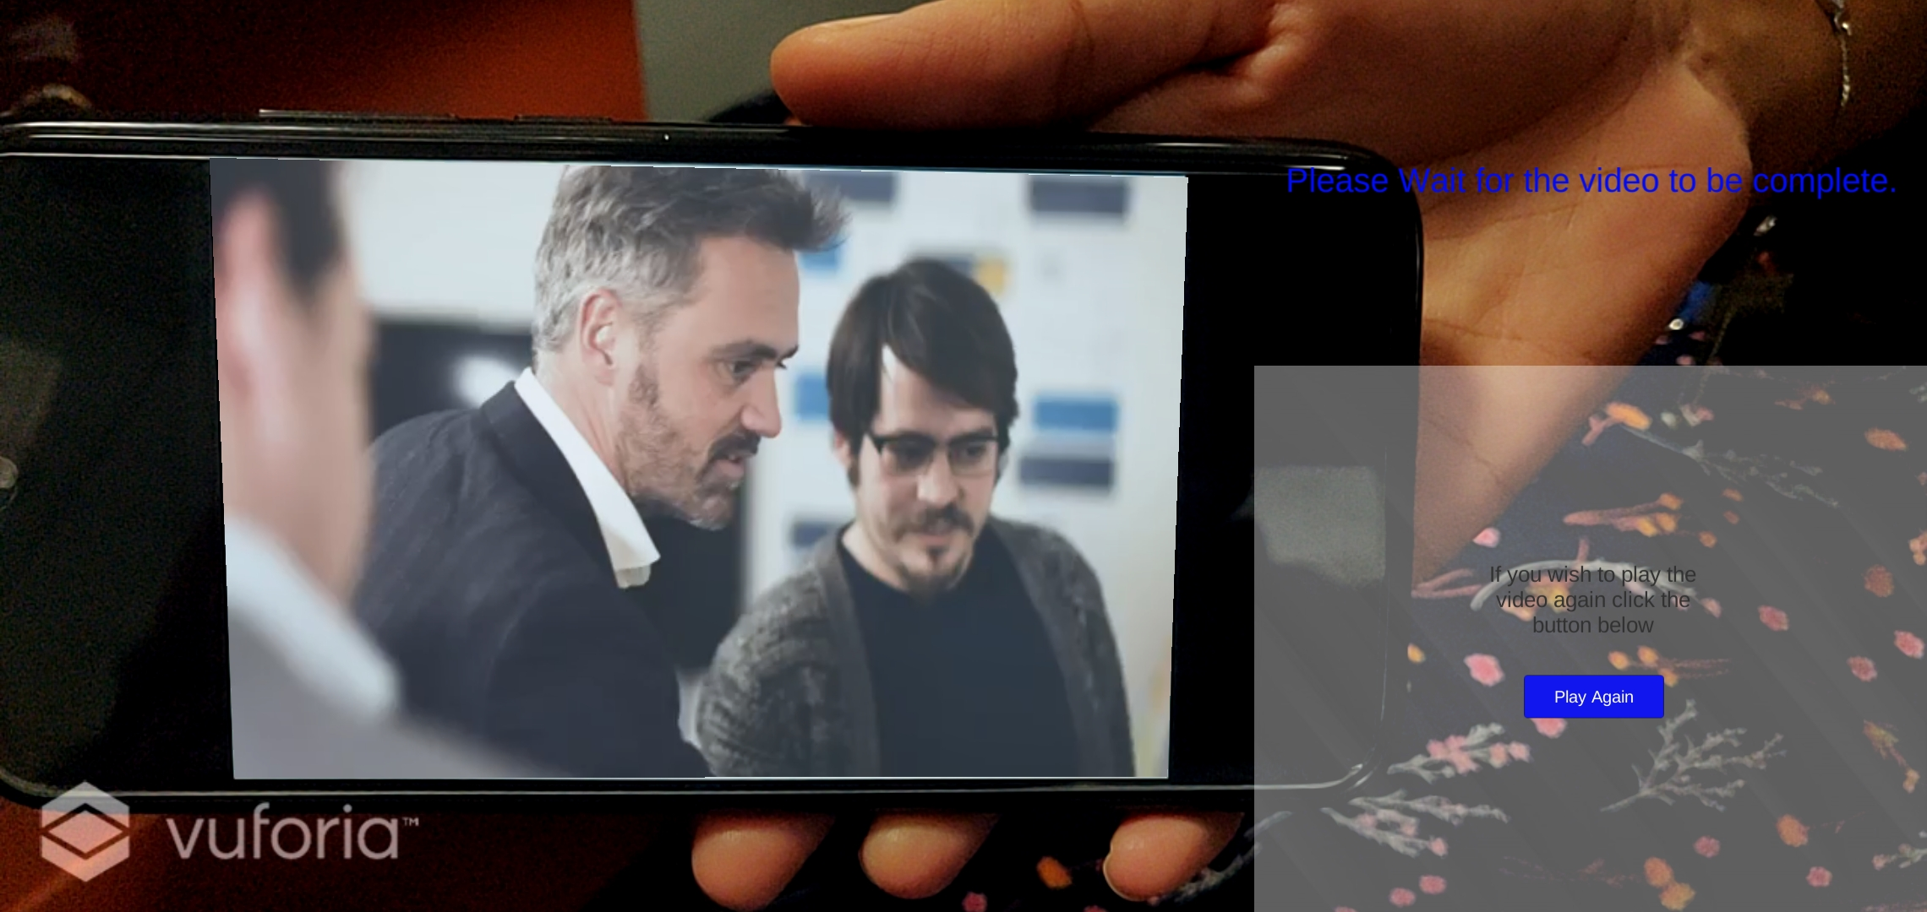
The Innovators: Enhancing Factory walkthrough with augmented reality
TEAM MEMBERS: Suryaprasanth, Swetha, Nanthabala, Rajkumar, Sathyapriya
BENEFIT/OUTCOME
Using AR we can reduce the need for long texts for representing processes.
Using AR will make the presentation standout from other firms.
IDEA DESCRIPTION:
To make the factory walkthrough experience more interesting for the clients by using Augmented Reality.
BUSINESS SCENARIO
SOLUTION / APPROACH
At present the factory workflow is demonstrated using videos and presentations.
To make the presentation more interesting and enjoyable for the audience we can use AR technology to give them a detailed explanation of the Factory processes.
Use marker based approach to make the user point a phone/tablet to a designated marker.
Once marker is in frame, animations/video are displayed.
Use different markers for one particular part of the factory.
Markers can be a plain cardboard or a sheet with a particular text as marker.
Tools and technologies:
Unity,
Vuforia AR Engine
Latest IOS or android phone/tablet.
TARGET CUSTOMER
All clients and customers who want a walkthrough of the Factory.
OPPORTUNITY
VALUE PROPOSITION
Impress clients with a captivating presentation.
Make it less boring by delivering key details within a short period of time.
Visual representations have a wider reach than texts/words.
Captivating walkthrough experience with AR.
Simple to implement using a phone or tablet.
Deliver detailed walkthrough in a short time.

